Slide 1

Running man from
By GongMing

Slide 2
Process plan
Grouping
Pressure plate relay race
Guessing
Dodgeball
Rope skipping
Nameplate ripping

Slide 3
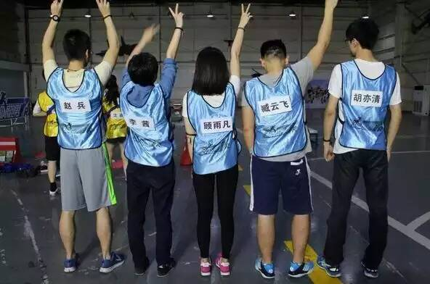
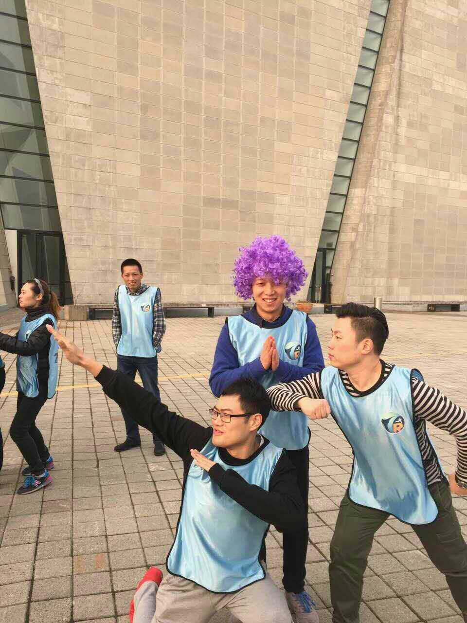
RM Grouping
You never know who will be your teammates.That is why we call this step interesting-grouping or destiny-grouping.

Slide 4
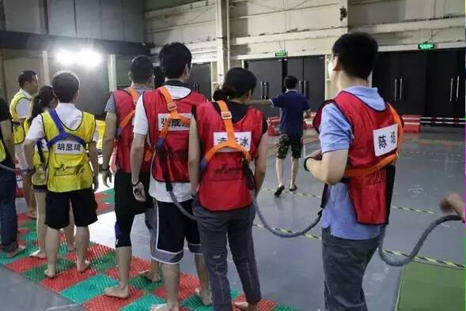
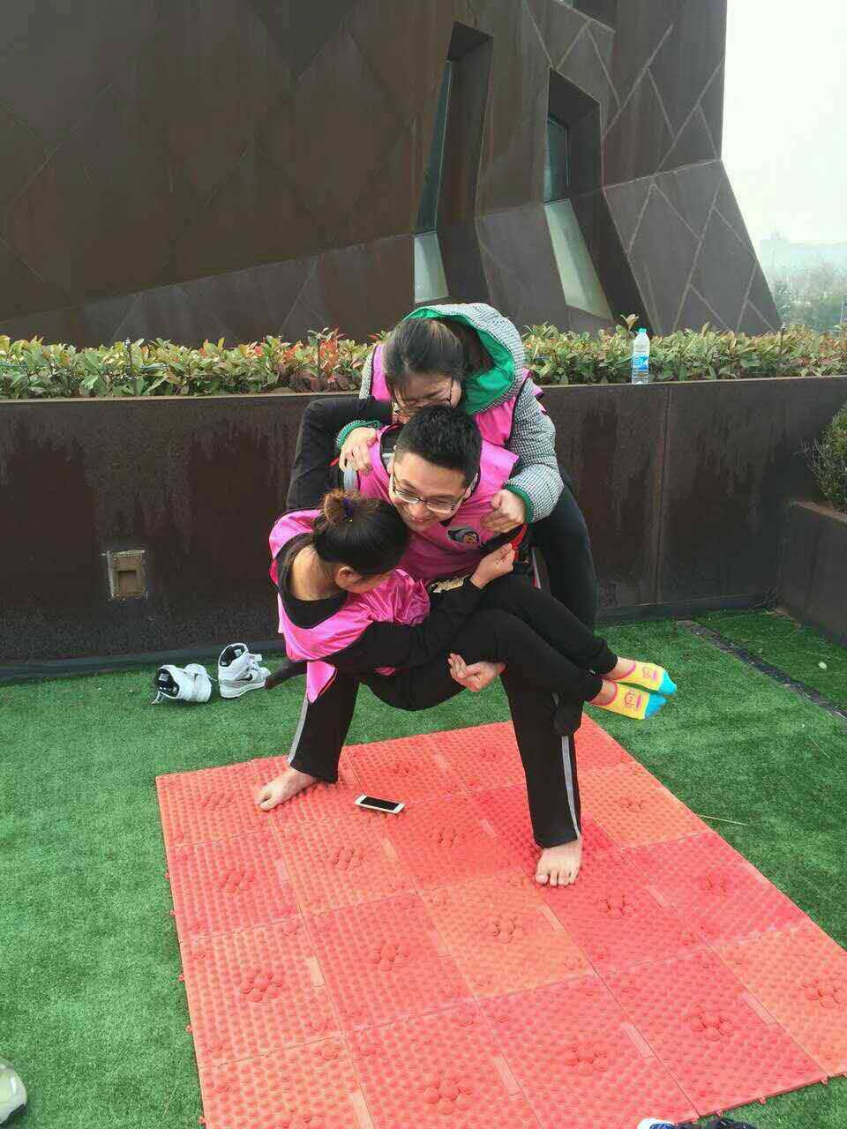
Pressure plate relay race
Team play.
This is the team challenge.
The winning team will get a great advantage in the next step.

Slide 5
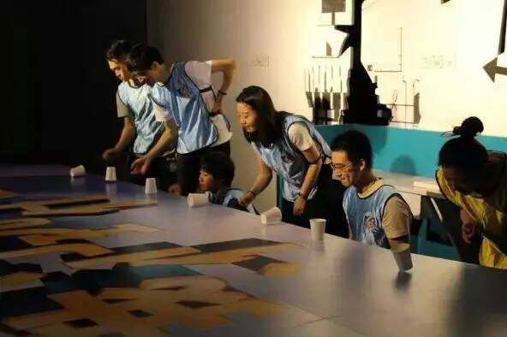
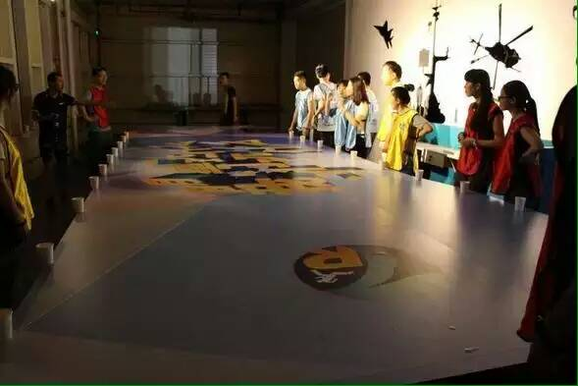
RM Guessing
In this step,each team pick a member as guesser,the others will be actors.Actors use body-langruage to tell the guesser the word which is behind him.
Each team have 5 mins.

Slide 6
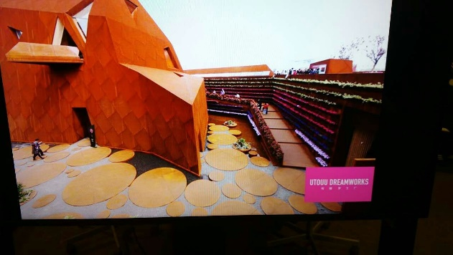
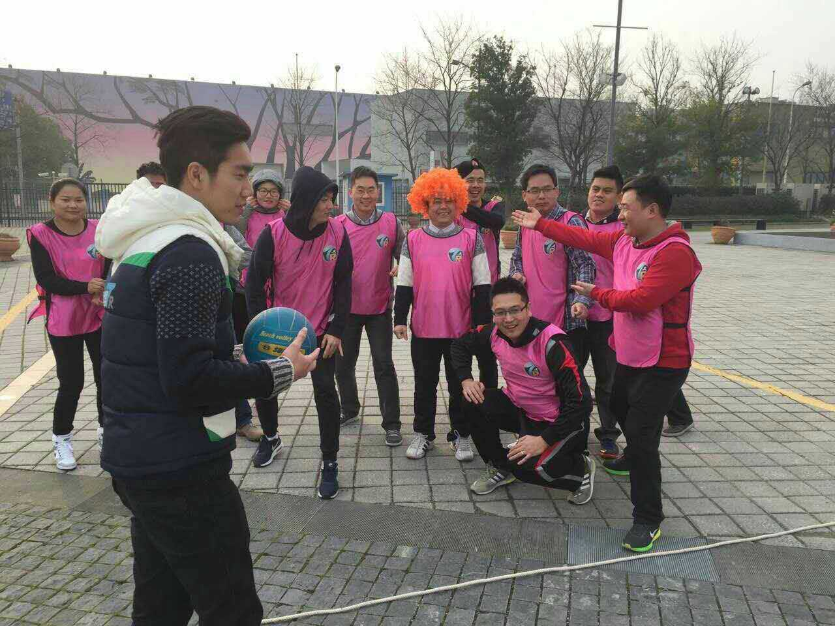
RM Dodgeball
Simple rules.
You can catch the ball.If you touch the ball,and did not catched it,you out.

Slide 7
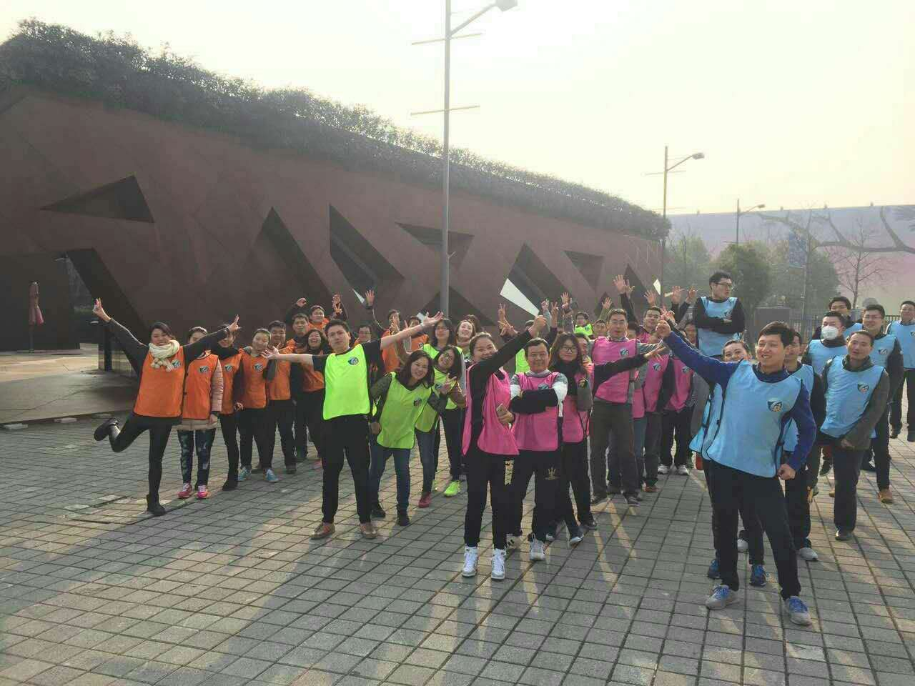
RM Rope skipping
Each team have 3 times to challenge team rope skipping.
Maybe you want to challenge rope skipping with you all.
It’s up to you.

Slide 8
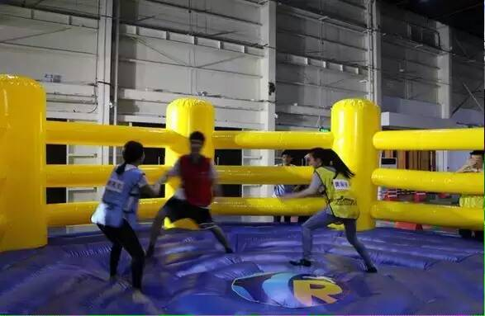
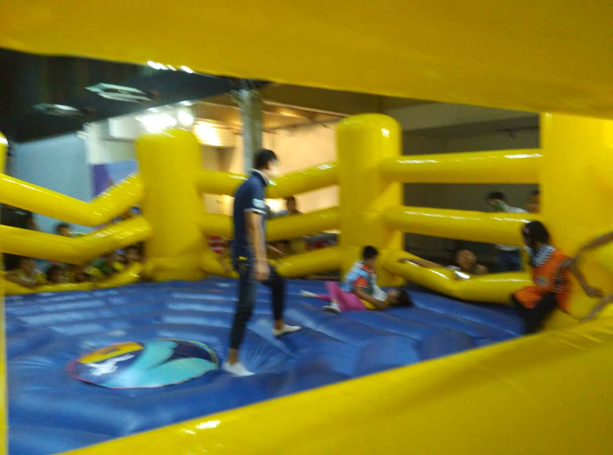
Nameplate ripping
Time to crash your enemy.
We have only one tip:
Show no mercy.

Slide 9
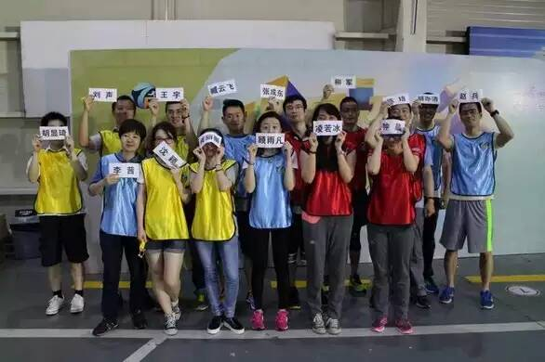
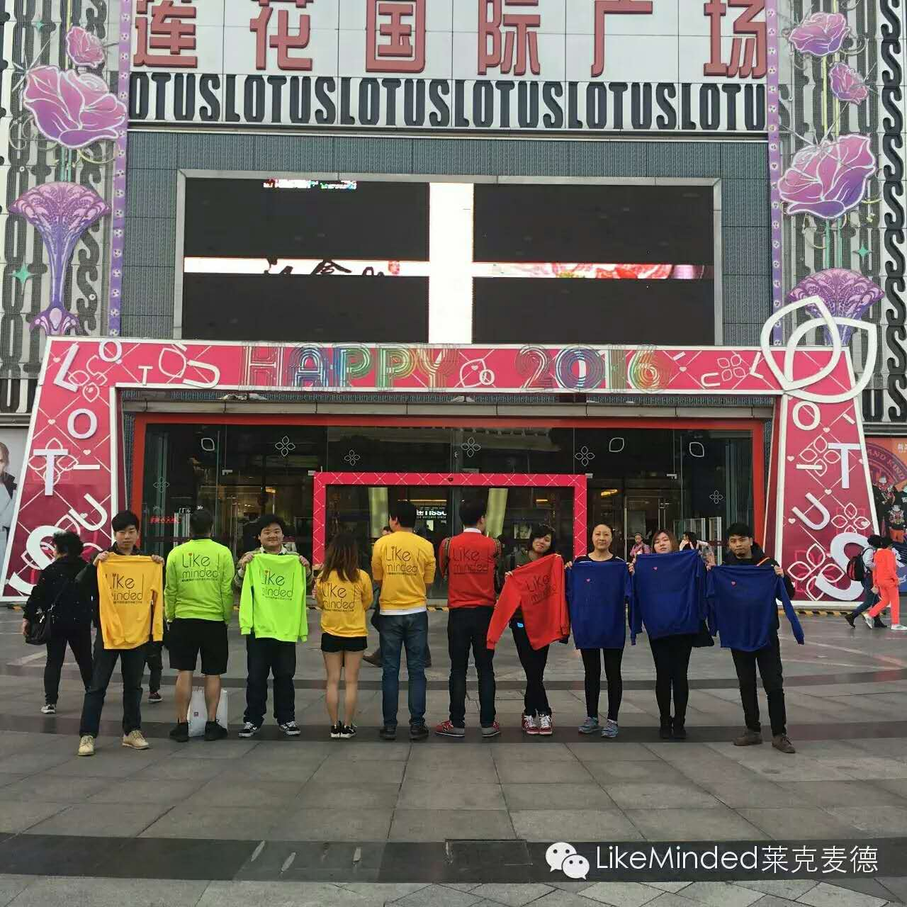
About us
Our business scope includes teambuilding/road show/exhibition/party.
Don’t ask me what to eat,because I don’t know.
Please ask me how to play,because we are professional.
Foreign customer manager:Gongming
Tel:13661662431

